Slide 1
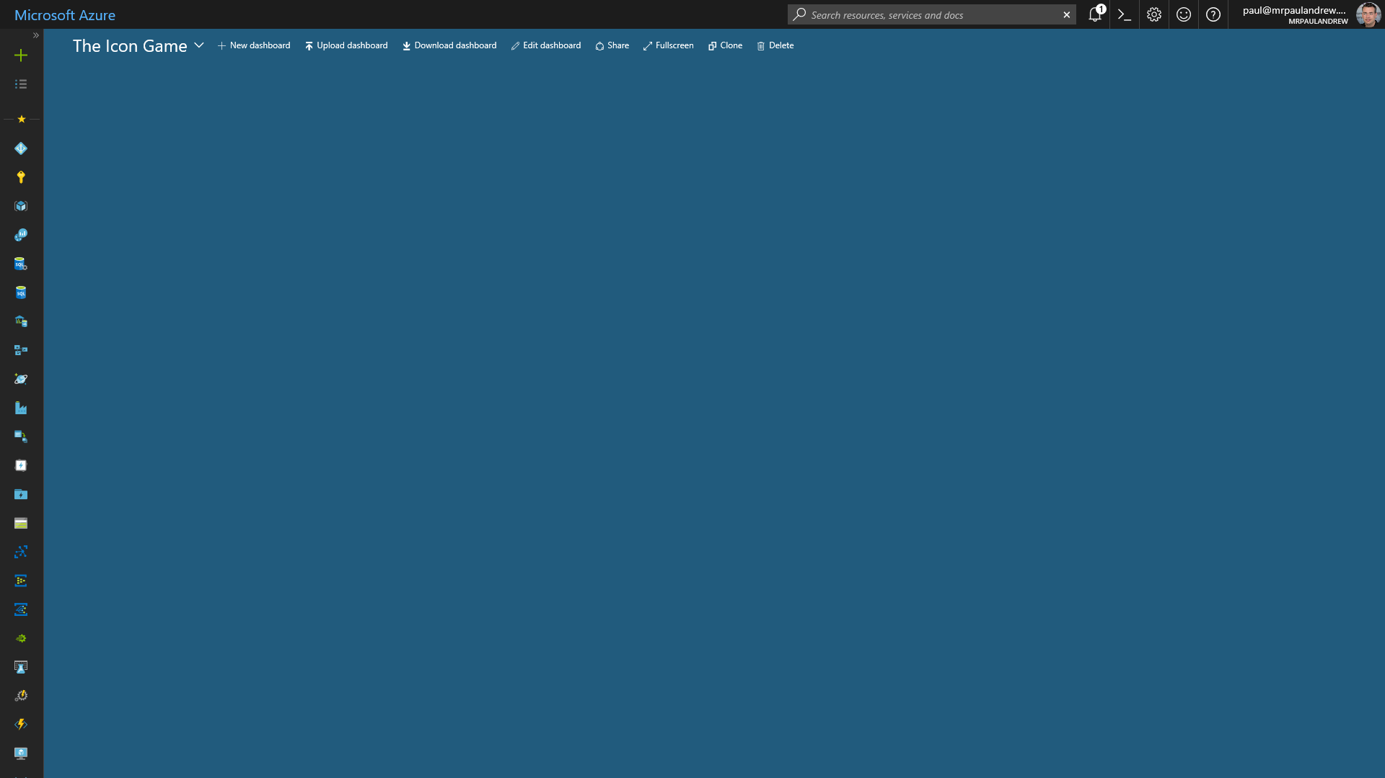
?
?
?
?
?
The Azure Icon Game

Slide 2
Microsoft Azure

Slide 3
Virtual Machine

Slide 4
Cosmos DB

Slide 5
Azure Active Directory

Slide 6
SQL Database

Slide 7
Azure Advisor

Slide 8
Resources

Slide 9
Virtual Network

Slide 10
SQL Data Warehouse

Slide 11
Cognitive Services

Slide 12
Data Bricks

Slide 13
Machine Learning

Slide 14
Storage Account

Slide 15
Data Lake Store

Slide 16
Data Lake Analytics

Slide 17
Data Factory

Slide 18
Batch Service

Slide 19
Automation

Slide 20
Functions

Slide 21
Logic Apps

Slide 22
Analysis Services

Slide 23
Event Hub

Slide 24
Event Grid

Slide 25
Stream Analytics

Slide 26
Data Catalogue

Slide 27
Key Vault

Slide 28
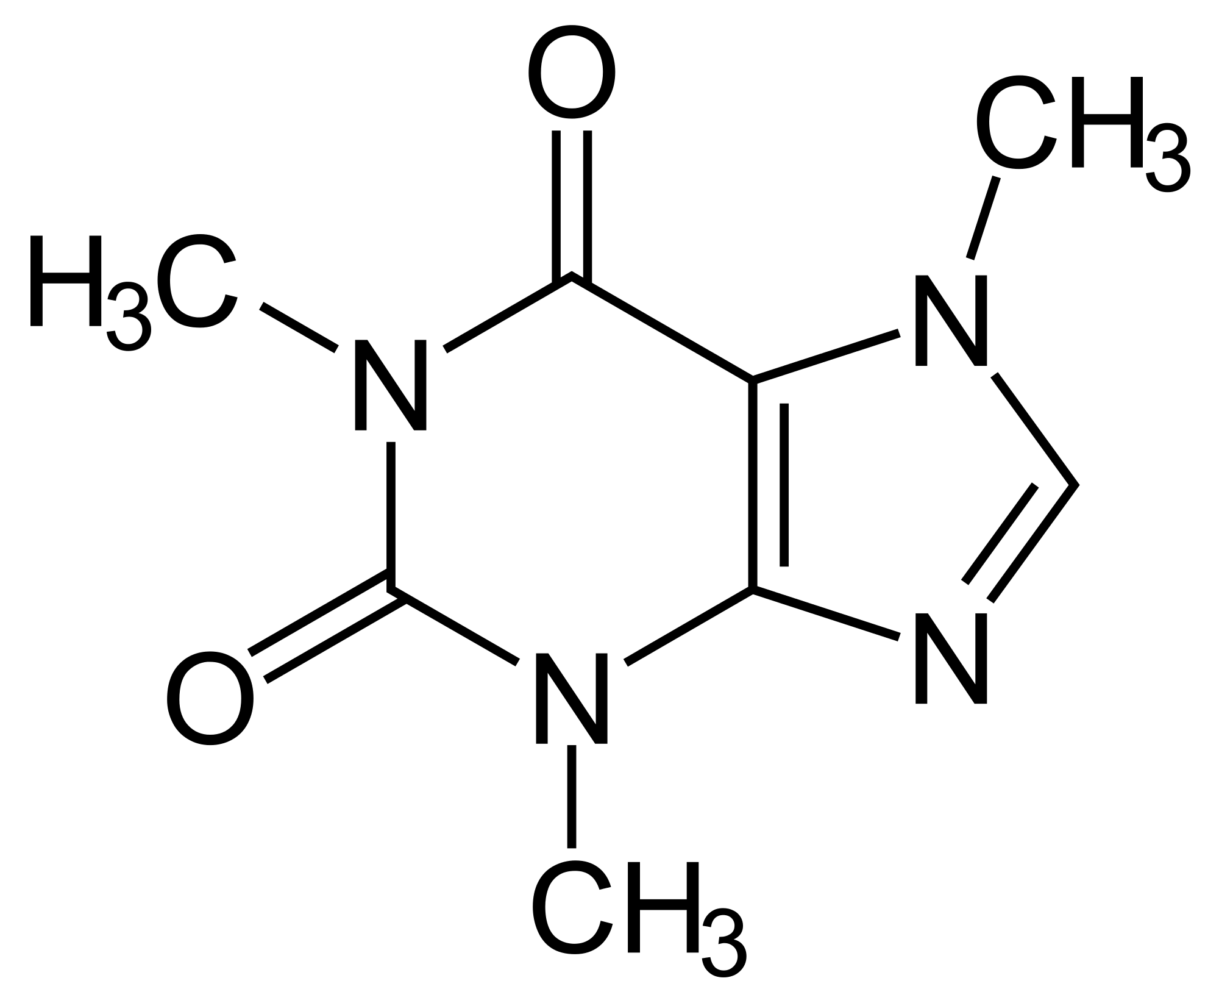
Caffeine

Slide 29
?
?
?
?
?
The Azure Icon Game

Slide 30
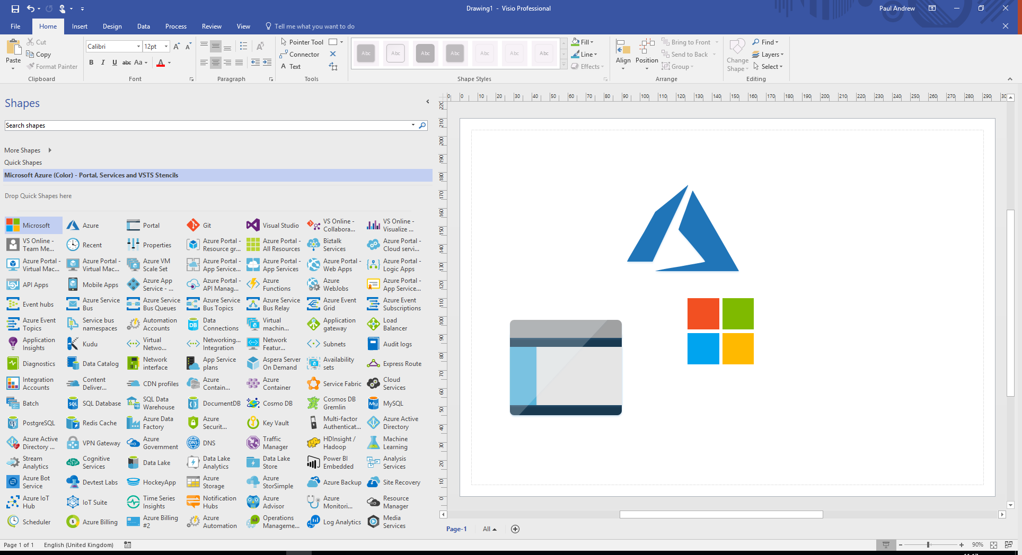
https://www.microsoft.com/en-gb/download/details.aspx?id=41937

